Slide 1
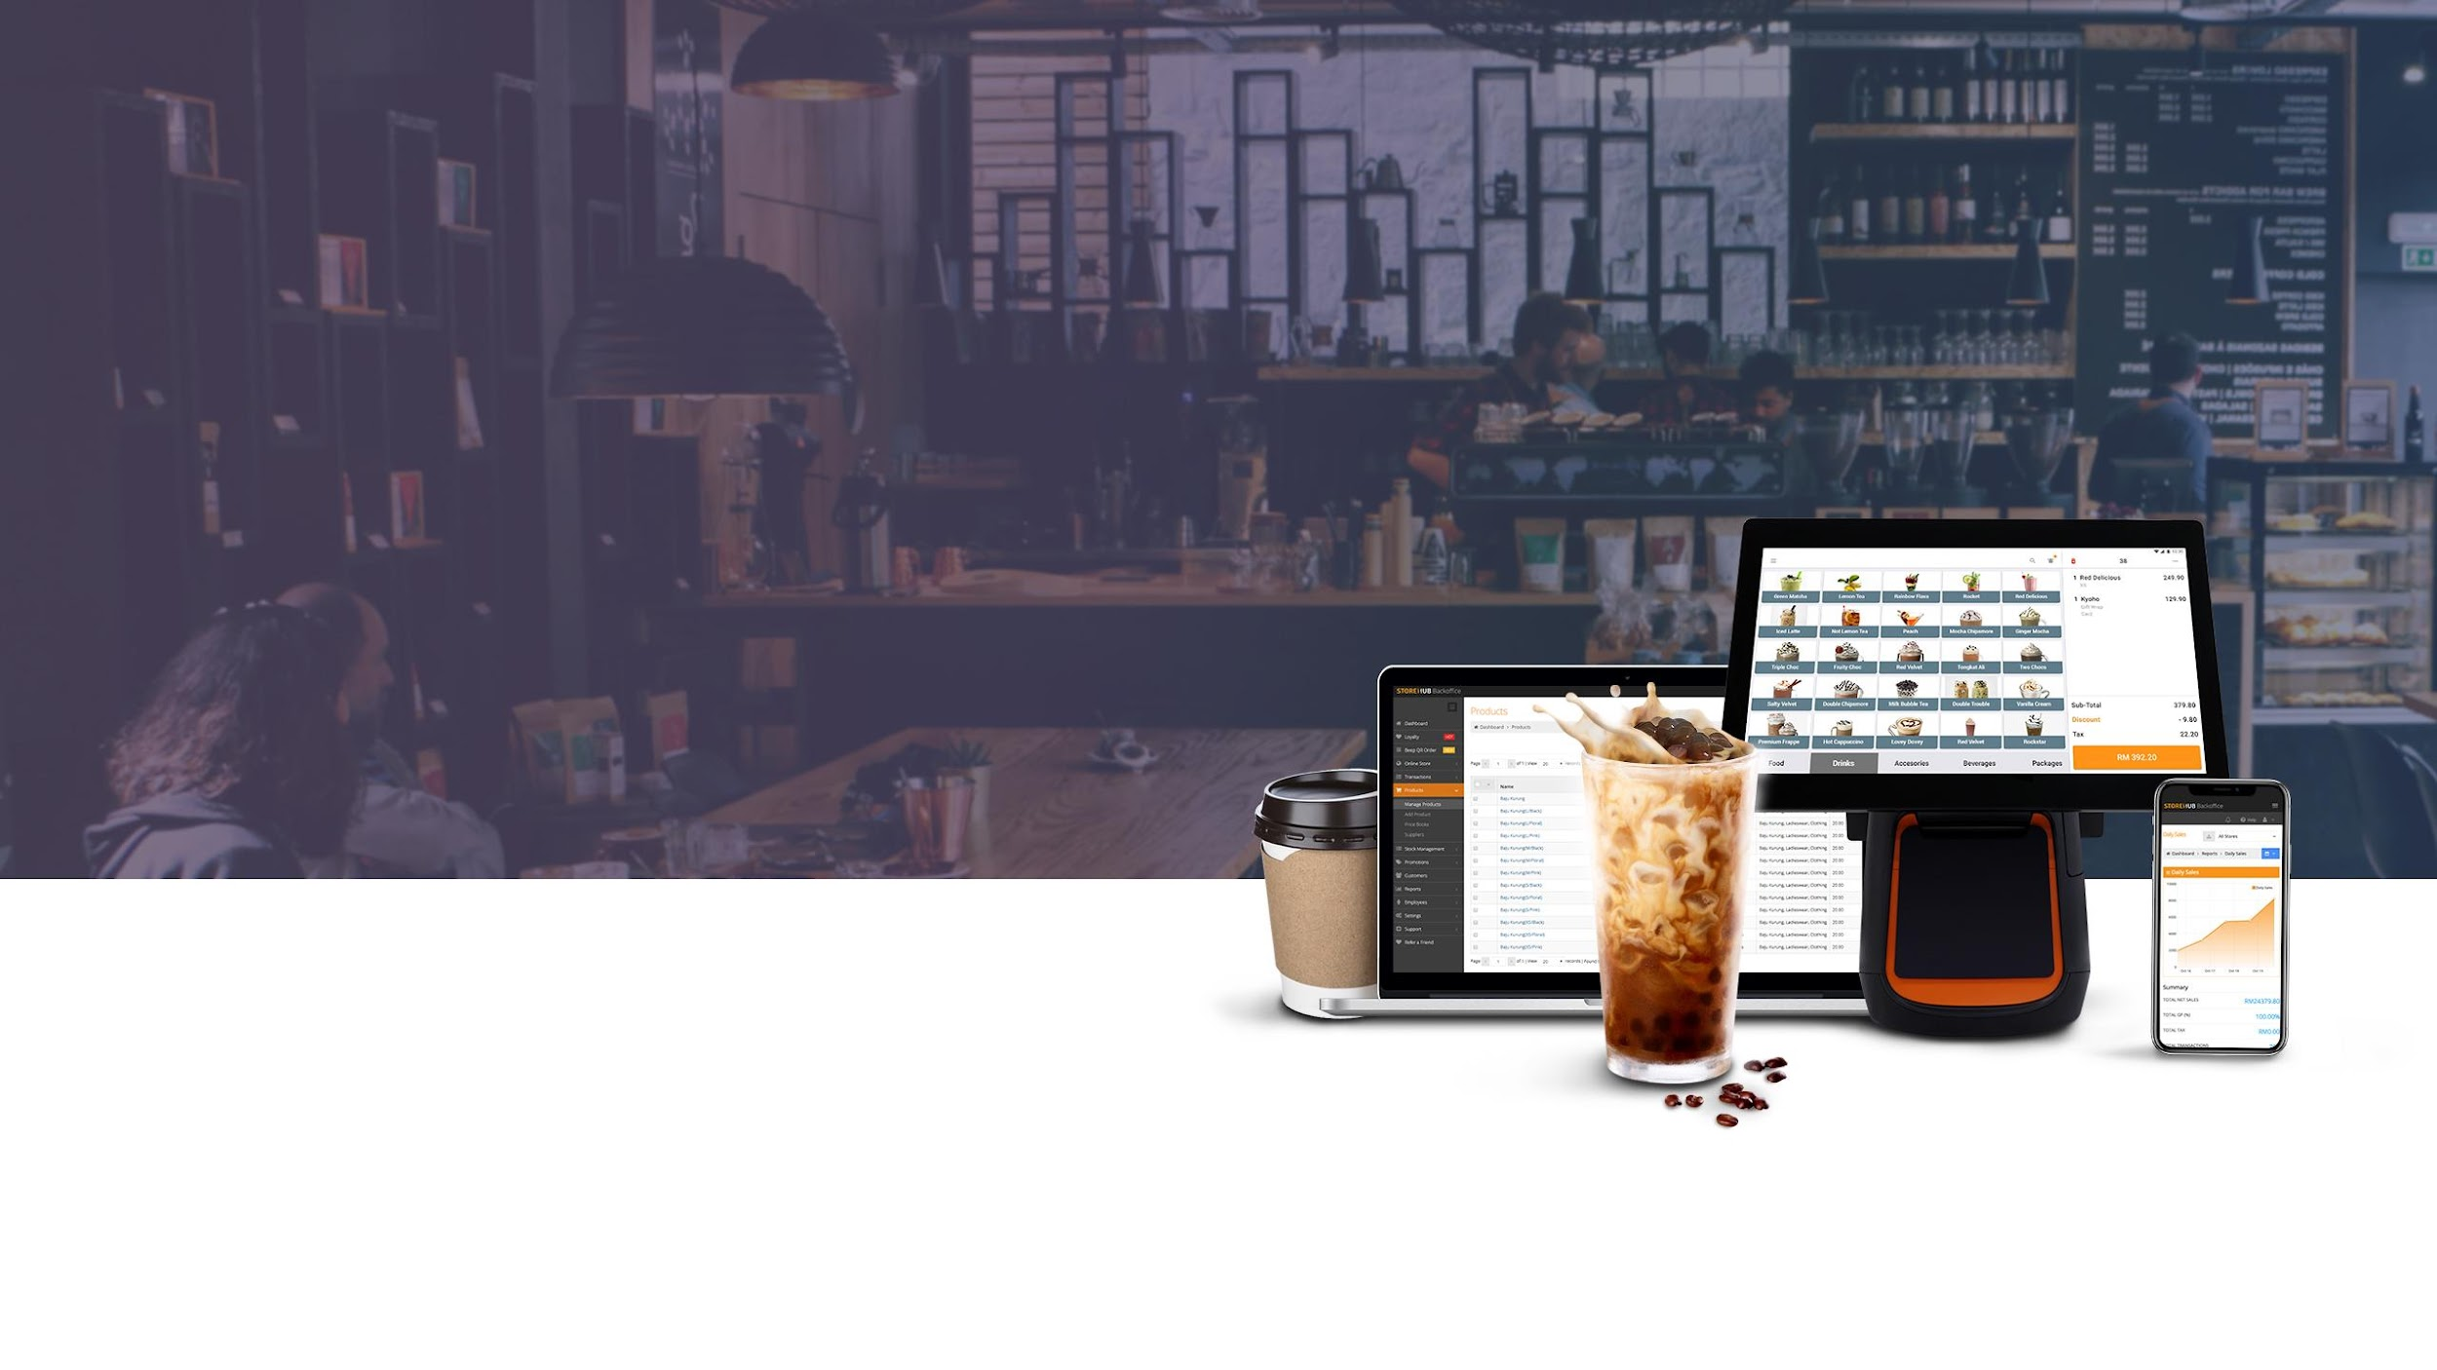
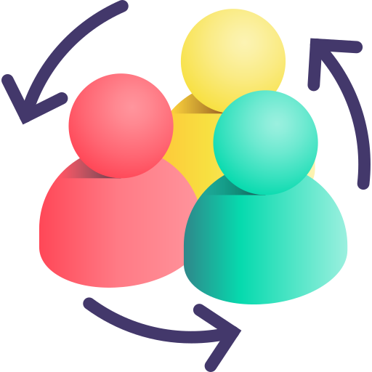

People Engagement

Slide 2


Pitching Flow

Slide 3
Pitching Flow
Introduction
Rapport Building
A.C.E.
Objection Handling
Merchant reject
Company Introduction
Echo & Summary
Proposal
Negotiation
Merchant accept
Closing
S.P.I.
Product Demo
Merchant undecided
Follow Up

Slide 4

Pitching Flow
Rapport Building
You will first establish rapport with Merchant. Establish rapport with merchant to make him or her feel comfortable
Steps
Examples
Asking Questions The best way to build rapport is to use questions that show interest; then, listen closely and respond appropriately
Sincerity Your sincerity and interest must come through and be perceived by merchant. Key concepts:
Be sincerely interested
Pick up on cues
Do your homework
Be client-centric
Be well-mannered
Some examples of openers you can use are:
“Wow, your shop is really big”
“There are so many customers at your shop”
“Wow, how long has this shop been running”
Before commencing the meeting, you are required to get permission from Merchant to record the meeting. It can be a simple statement of:
“Hi Mr. Merchant, just to inform you that this meeting
will be recorded for training and quality purposes.”

Slide 5
Pitching Flow
A.C.E.
To portray a positive image by communicating with a cheerful and energetic tone
English Script
A
Appreciate
Any time you begin a meeting, it’s important to let the person on the other end of the line know that you appreciate their time
Good Morning , My name is [BC Name] from StoreHub. Thank you for taking time for the meeting today. This meeting will take around 45 minutes to 1 hour. Throughout this meeting, I will be asking you a few questions to understand your business better so that I may propose the best solution for you. If you find that we are a good fit for your business and are able to provide value, we will set some clear next steps on how to move forward with this at the end of the meeting
C
Confirm
It’s always important to quickly confirm how much time everyone has for the meeting before you get started
E
End Goal
Setting and agreeing on an end goal that is customer focused, but still aligns with your goals is essential to making sure your meeting stays on track from the start

Slide 6
Pitching Flow
Company Introduction
Present this section with clarity and walk the Merchant through what StoreHub is, demonstrating our company's credibility and stability via relevant social proof - Our customers and investors
English Script
StoreHub is a technology based platform serving over 15,000 stores across Southeast Asia. Our headquarters/main office is located at Malaysia, and we have 3 branch offices located at Thailand, Philippines and China
StoreHub is able to serve businesses from the retail, F&B and service industry. Some of our larger merchants include popular brands like [Retail Examples] for retail, and [F&B Examples] for F&B. StoreHub is backed by global investors from US, Malaysia, Singapore & Japan. Our largest investor, Vertex Ventures is a subsidiary of Temasek, which is the sovereign fund of Singapore

Slide 7
Pitching Flow
S.P.I
What is S.P.I.
SPIN is a collection of questions to be asked in a specific order
S
P
I
Situation
Problem
Implication
Questions

Slide 8
Pitching Flow
Situation
S
What is Situation Questions?
Example of Questions:
How do you do X?
Who’s responsible for X?
What’s your process for X?
How long have you done X this way?
Do you have a strategy in place for X?
To gain a thorough understanding of the prospects' position - from their processes, pain points, and opportunities to their competitive plans and results
X being:
Tracking sales
Tracking inventories
Sending sales reports
Identifying your best selling items for the month

Slide 9
Pitching Flow
Problem
P
What is Problem Questions?
Example of Questions:
How long does it take to do X?
How expensive is X?
How many people are required to achieve the necessary results?
What happens if you’re not successful with X?
Does this process ever fail?
To identify areas of potential growth and provide the optimal solution
X being:
Tracking sales
Tracking inventories
Sending sales reports
Identifying your best selling items for the month
Maintaining your regular customers

Slide 10
Pitching Flow
Implication
I
What is Implication Questions?
Example of Questions:
I understand how frustrating it is on your end to [pain point/s]. If there was a way to have an all-in-one platform for real-time sales and inventory tracking, as well as your own & exclusive ordering site, would you consider it beneficial for your business?
That is well noted, and how do you feel about [current provider] charging you this much?
Discuss the problem's consequences and amplify its gravity to increase the merchant's motivation to change
This assists the merchant in visualising what they are missing and thus increases their willingness to use the StoreHub System

Slide 11
Pitching Flow
Product Demo
A clear step by step demonstration on BackOffice and POS. Provide relevant product demo based on merchants interest
Example
Based on the needs assessment performed previously, we should have already managed to gather at least 2 to 3 pain points from the merchant. We will then move on to conduct a product demo based on merchant’s requirements. The main purpose of the product demo is to demonstrate how the system works, and more importantly how it is able to solve the merchant’s pain points and provide value to their business.
Pain point:
Stock
Demo:
Should be more focused on the inventory features. Once solving the pain, then only moving on to other values & features to upsell the system. This will ensure that we solve merchant’s core problems and show them the value which boosts their confidence towards the system, before attempting to upsell features which they initially didn’t think of/require.

Slide 12
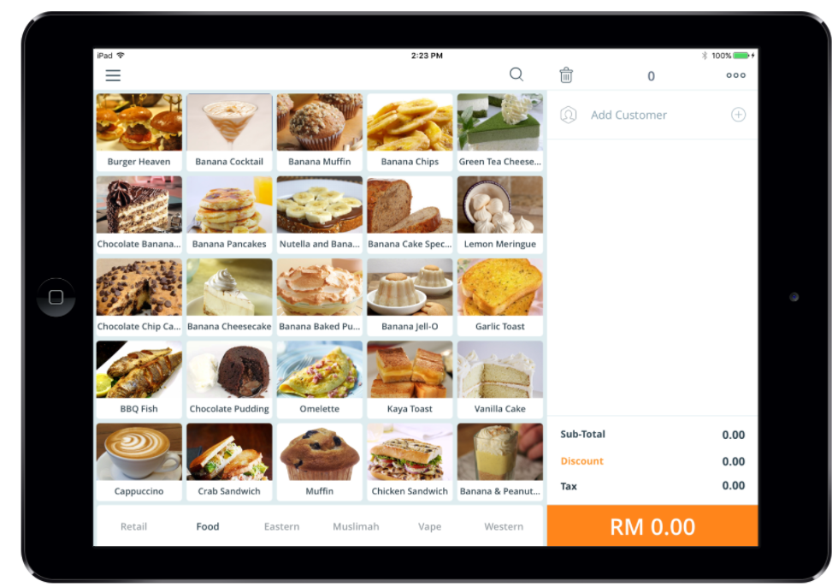
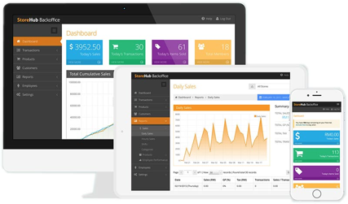
Pitching Flow
Product Demo (cont.)
iPad/Android Front End Register
BackOffice
Clock in / Clock Out
Open / Close Shift
Shift Report
Pay In / Pay Out
Performing a Transaction
Cancel/Refund Transaction
E-wallet Integration
Discounts
Save Order
Table Layout
Pre Order/Pick Up
CRM
Dashboard
Reports
Stock Management
Customers
Promotions
Employees
Cashback

Slide 13
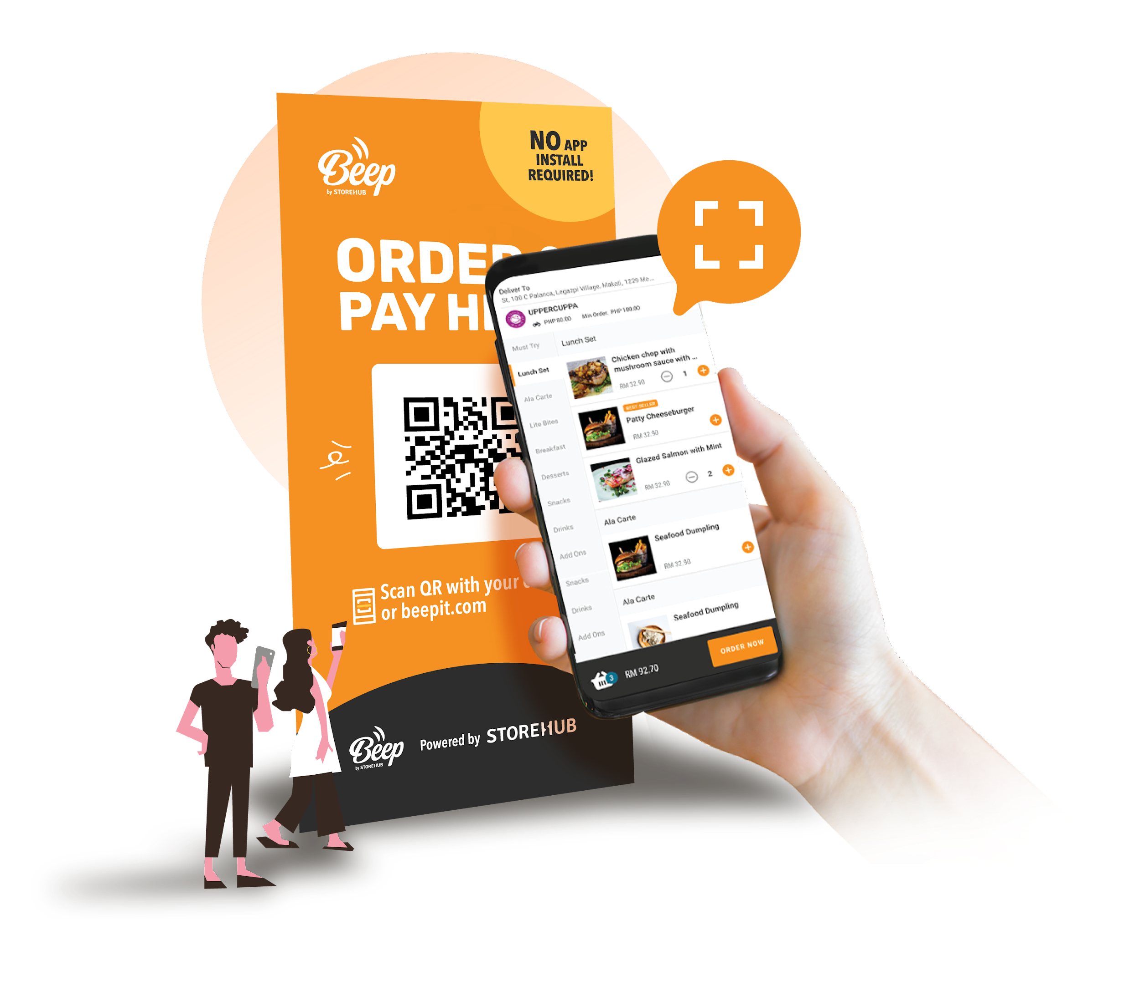
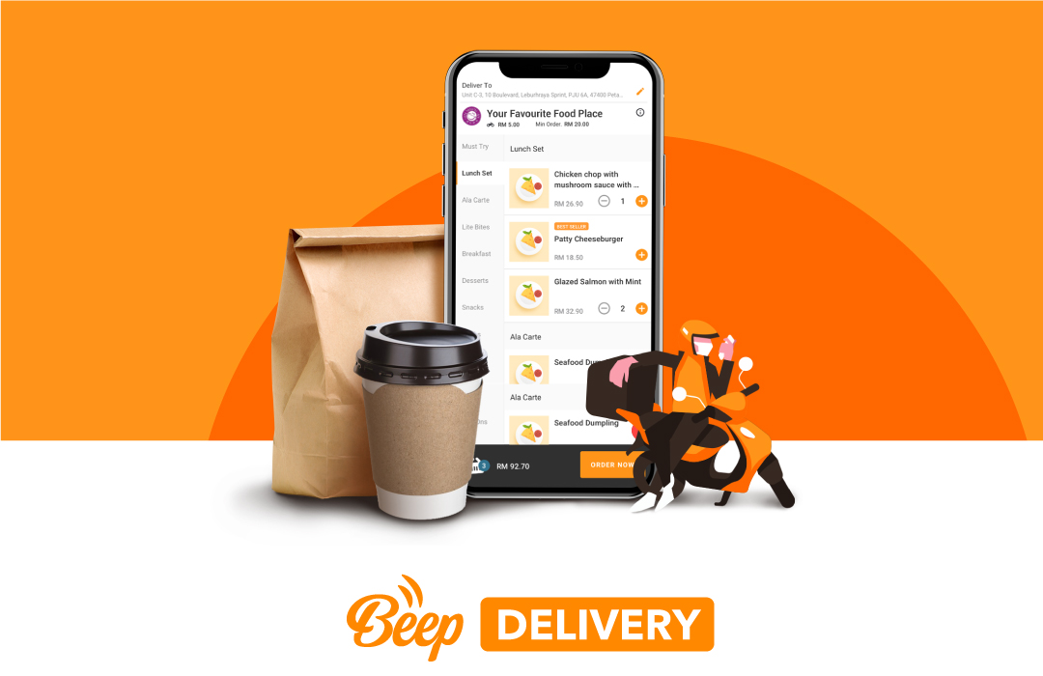
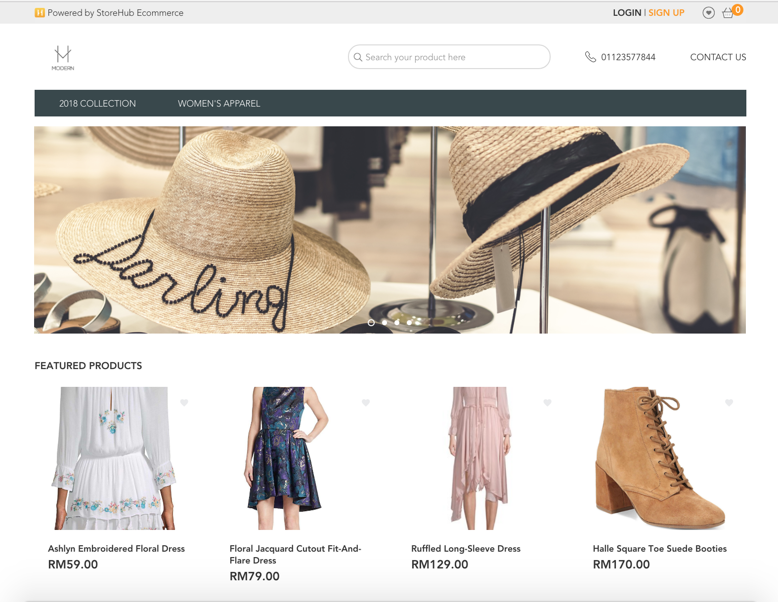
Pitching Flow
Product Demo (cont.)
QR Order and Pay
Beep Delivery
Webstore
F&B
Retail

Slide 14

Pitching Flow
Echo & Summary
It is important to perform a quick check with merchant on how he/she finds the system after the product demo
As a BC, we must ask merchant ‘What do you like best about the system?’ and get them to summarize the values for the system
If they are unable to do so, it suggests that they did not perceive any value in the system
Echo merchant and summarize the values once more before proceeding to pricing
Ensure merchant finds value in our pitch, and also relate that value to any pricing objections later on

Slide 15
Pitching Flow
Proposal
Ensure that merchant clearly understand that the pricing is split into the hardware & software cost
Hardware
Software
Other
Propose the best hardware package based on the merchant’s requirements
Example:
iMin D1 / D4
Cash Drawer
Kitchen / Docket Printers
Wi-Fi Router
Handheld Scanner
Bixolon Printer
Explain the differences between the 3 plans and recommend the most suitable plan
Example:
Starter
Advance
Pro
It is a must to inform merchant that the software cost consists of Cloud server maintenance cost, website maintenance cost, hardware support (1-to-1 exchange for replacement unit), software support (Monday - Sunday | 9am - 9pm), all future upgrades free and assure merchant that there is no hidden cost for the system

Slide 16
Pitching Flow
Negotiation
A negotiation between a buyer and a seller to close a sale
Create the urgency and get the merchant to close on the spot (COTS)
Offering discounts depending on what merchant requires and get them to pay on the spot
If they need to discuss with another discussion maker, ask them if it is possible to contact the partner now

Slide 17

Pitching Flow
Objection Handling - Introduction
Why is Objection Handling is important?
An objection presents you with an opportunity to learn more about merchant
It enables you to ascertain their ACTUAL needs, desires, and concerns (NWC)
It demonstrates credibility:
Merchant want to make sure you know the Product
They need to see if they can put their trust in you
Unless you overcome the objection, they will never feel secure enough to proceed

Slide 18

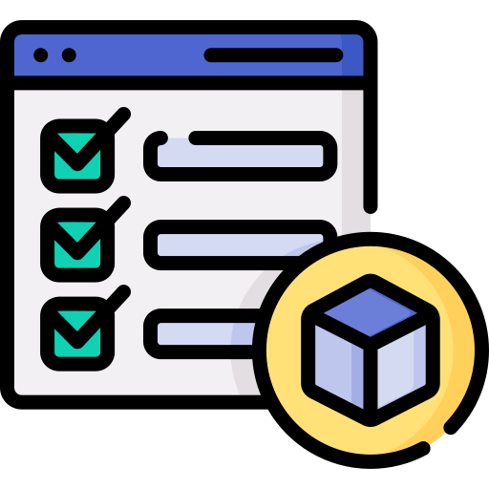
Pitching Flow
Objection Handling - Types
Pricing Objection
Feature Objection

Slide 19
Pitching Flow
Pricing Objection
Framework for Pricing Objection
Identify
Pricing Anchor
Reasoning
Quantify
Identify the pricing area at which merchant is directing his or her objection
Hardware pricing or is it the recurring software
Find out their Pricing Anchor. The merchant may compare our pricing to something comparable or to a different product. The primary reason merchant believes they are paying too much is because
They don’t see the value in the system as a whole
Once you have identified the pricing anchor of the merchant:
Explain to the merchant that the reason our solutions are more expensive than those of our competitors is because they are able to solve their problems.
Connect it to the problems that only we are able to solve. Highlight the areas covered in your needs analysis
Quantify the value that our product can provide to the merchant. Provide a breakdown, in ringgit, of how much they are able to:
SAVE by using BEEP QR to reduce headcount and manpower
EARN by using BEEP Cashback and BEEP delivery;

Slide 20

Pitching Flow
Pricing Objection - Scenario
Merchant takes issue with the recurring pricing as the merchant has met with other competitors that offer one off payments for their point of sale (POS) system
I feel that your pricing is a little high
Which part of our pricing do you feel is expensive? Is it the hardware or the software?
It’s the software. I think having to pay RM2490 every year is very expensive
StoreHub
Merchant
Oh I see. Why do you think that’s expensive, are you comparing the pricing with another system?
Yeah I’m comparing it with other POS vendors that are providing one off payment and don't require me to make repeated payments
Okay. However, just to clarify, are these systems capable of performing the features we discussed earlier? Just wanted to reiterate that we are a fully integrated system that can help you manage your operations with the POS and BEEP QR, as well as grow your business with BEEP cashback and BEEP delivery. RM2,490 may appear to be a high price compared to a simple POS system.

Slide 21
Pitching Flow
Feature Objection
Framework for Pricing Objection
Problem
Identify
Solution
Deal Breaker
Ask merchant why they need the feature and what is the problem they are trying to solve
After finding out the problem, identify if merchant already has an existing solution for the problem
Determine if the solution to the problem is a deal breaker or just a mild inconvenience
If the feature required is a deal breaker, find out the best workaround solution
If merchant agrees with the workaround, proceed with the solution
If not, redirect merchant as to the trade off that merchant is making
If the feature required is not a deal breaker and just to solve a mild inconvenience, refocus merchant’s attention on the main value propositions of the solution

Slide 22
Pitching Flow
Feature Objection – Scenario (cont.)
Merchant is asking for credit terms feature for their clothing business as they sometimes offer instalment plans to their consumers for large purchases. They only do a sale like this once in a month and it’s not a big deal
Is your system able to record credit terms for my customers?
Oh, why do you need to record this, may I understand what situations you would use this feature for?
I have customers who order dresses from me which are in the range of RM10,000 - RM20,000. Typically we offer these customers credit terms and they will pay off in instalments of 2-5 payments, depending on the customer’s ability. We need something to help us to track these instalment payments.
StoreHub
Merchant
I see, how are you currently tracking them with your current system?
Right now we do it completely manually, and we track each customer’s instalment payment in a spreadsheet

Slide 23
Pitching Flow
Feature Objection – Scenario
Merchant is asking for credit terms feature for their clothing business as they sometimes offer instalment plans to their consumers for large purchases. They only do a sale like this once in a month and it’s not a big deal
I see. How many of your customers purchase these dresses every month?
This doesn’t happen very often. Maybe once a month?
StoreHub
Merchant
I see. So what we’re able to do is to track the instalments in 2 payments with our Pre-order function. However, we’re not able to do it for more than 2 payment terms, which means we won’t be able to track the payments for your customers who are paying in 3-6 instalments. Also you’ve mentioned that this only occurs once a month, do you think you’re able to use your existing method of tracking?
Yeah, I don’t think it’s a big deal to track these payments since they happen so infrequently

Slide 24
Pitching Flow
Closing
It is vital to establish clear next steps at the end of the meeting. Inform Merchant of the post-sale procedure if a sale is close on the spot. Clearly outline the next steps if they need to contact their partner.
Merchant Who Has Intention
Merchant Unable to Confirm
Push to close deal
Provide quotation
Confirm payment date & time or any follow-ups
Understand the reason
Offer a follow up date and time

Slide 25
Pitching Flow
Follow Ups
The purpose of a follow up call is to get a decision from merchant or move the deal forward
Inform of the reason for your call and establish the necessary steps to move the deal forward
You are required to call merchant once within the next few days following the meeting
Proceed to “Close Lost” stage in SalesForce if he/she does not answer your call.
Notes:
3. Follow up decision for at least 3 times, if customer unable to provide an answer proceed to Close Lost
Type a message...

Slide 26


Rapport

Slide 27
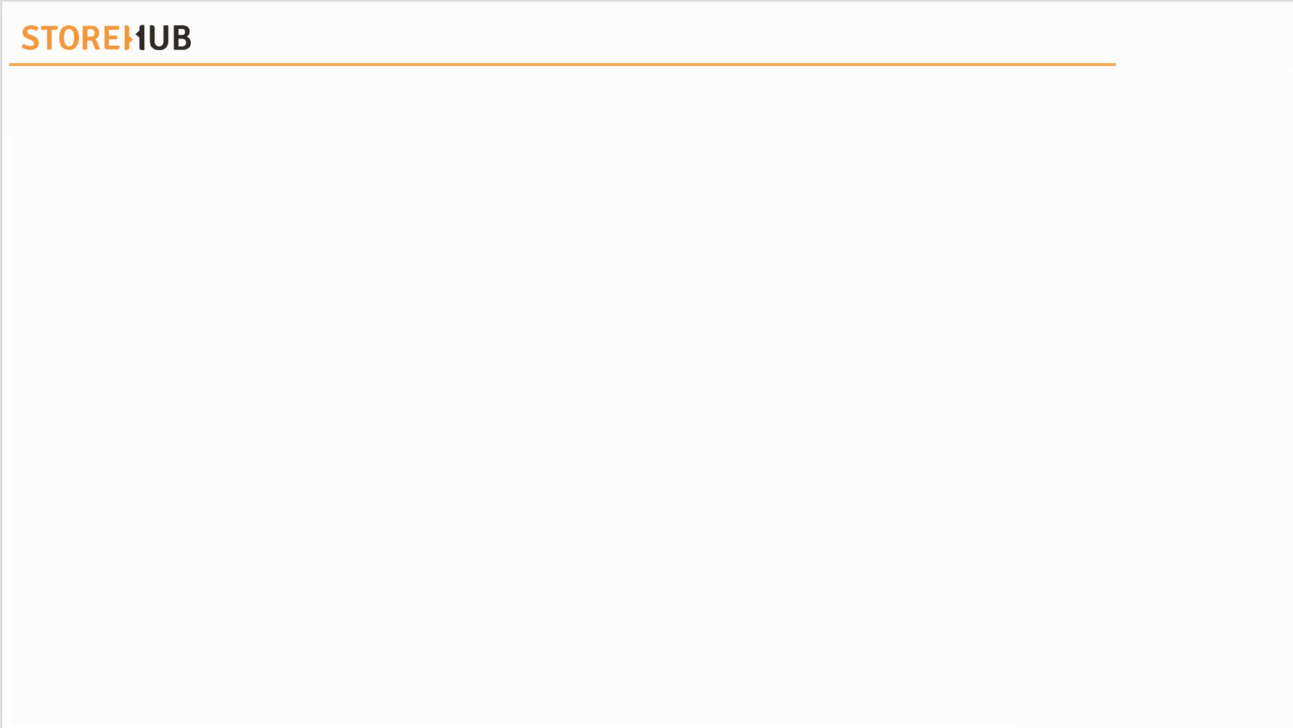

| Rapport
Introduction
Rapport is understanding each other feelings or ideas and communicate well.
What is rapport?
We need to build good relationships with merchant to show that we are trustworthy.
Why building rapport is important?
Personable
“Oh, I love that your business is associated with such a great cause”.
Good Rapport
Relatable
“Well I fully understand how busy you can get as a business owner”.

Slide 28




| Rapport
Techniques to Establish Good Rapport
Personable & Relatable
Mirroring
Tone
Active Listening
Empathy

Slide 29

Mirroring

Slide 30
| Mirroring
Introduction
What is Mirroring?
Why we should mirror merchant?
Speak and Act on the same wavelength
Mirroring can build rapport and a strong connection with others by allowing your
Merchant to open up with you
Be on the same wavelength as the merchant
Mirroring language is a way to say ‘I am like you, I feel the same’.
Gives the other party secure feeling of belonging
What is the criteria?
What are the steps of Mirroring?
Speak their Language
Mirror their Body Language
Speak their Language and Connect with their Behaviours
Mimicking physical actions/keywords mentioned by merchant
Pace & Volume
Identify the Punctuator
Test the Connection

Slide 31
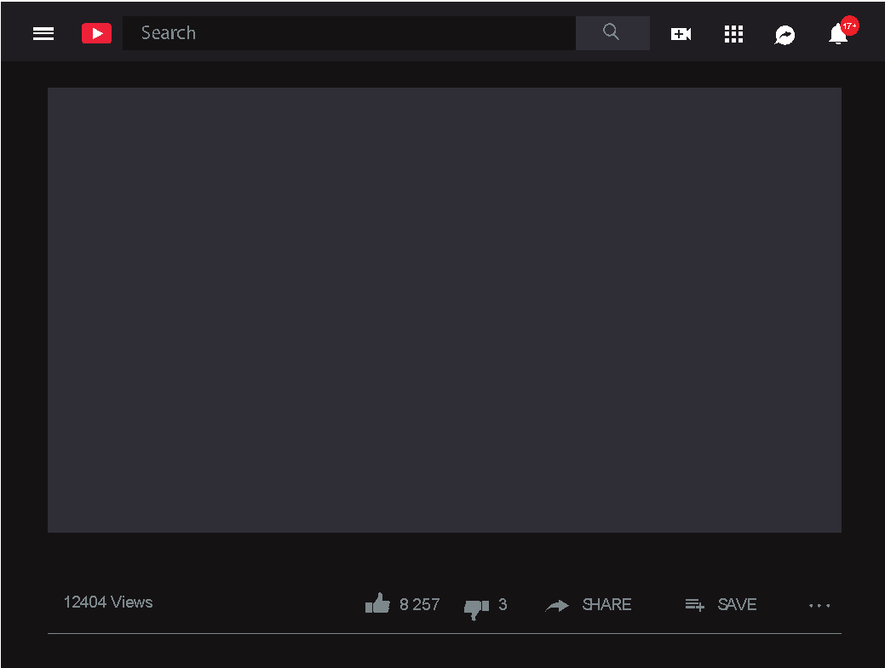

| Mirroring
Video

Slide 32

Tone

Slide 33




| Tone
Introduction
Start with a Positive, and end with another positive
Example : We can certainly do our best to help! I must say that feature is currently not available in our existing system, but there are a few alternatives I can suggest to you
Offer (appropriate) assuring remarks and/or gestures
Example : Wow, that’s great! (for actions, a reassuring nod)
Use the correct choice of words and be Friendly and Helpful
Tone
Good question, let me find out
I don’t know
Do’s & Don’ts
I wish we could
I can’t
Are you able to hold
Please hold
I’m positive / certain
Listen to me

Slide 34
Active Listening

Slide 35
| Active Listening
Introduction
Why Is Active Listening Important?
Active Listening helps to build trust and establish rapport
Active listening is essential to ensure that no information is missed
Paraphrase Merchant ’s concern to avoid misunderstanding / miscommunication.
Clarify if Merchant wishes to proceed with the request or just inquiring.
Ensure to have Merchant’s acknowledgement before making any changes to the booking.
Assuming Merchant’s concern/ request without clarifying.
Misinterpret Merchant’s concerns with requests instead of inquiries.
Make changes on Merchant’s booking without having their consent.
Do’s
Don’ts

Slide 36
| Active Listening
Video

Slide 37




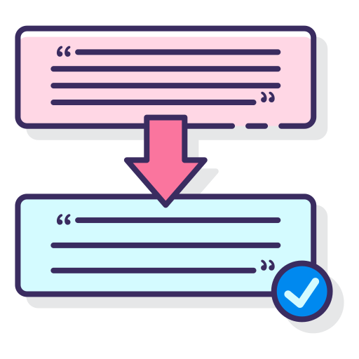

| Active Listening
Steps
Mental Notes
Acknowledge
Focus
Paraphrase
Reassurance

Slide 38


| Active Listening
Activity

Slide 39
Empathy

Slide 40

| Empathy
Introduction
Listen before you speak
Respect everyone cultural differences
Control your cadence, pace and tone
Validate concern by restating and echoing back other’s feelings and perspective

Slide 41
| Empathy
Empathy vs. Sympathy
Empathy refers to acknowledgment and affirmation of another’s emotional state.
Sympathy involves identifying with and even taking on another person’s emotions.
Empathy
Sympathy
Why don't I schedule our meeting for 3 p.m. and have it end just before rush hour so that you don't have to sit in traffic?
Given your past experiences, it is understandable that you are hesitant to use our system, so we will do our best not to disappoint you.
I hope you feel better soon.
This must be hard for you.
I am very sorry for what happened…
Acknowledge on the situation and show that you care
Acknowledge on the situation

Slide 42
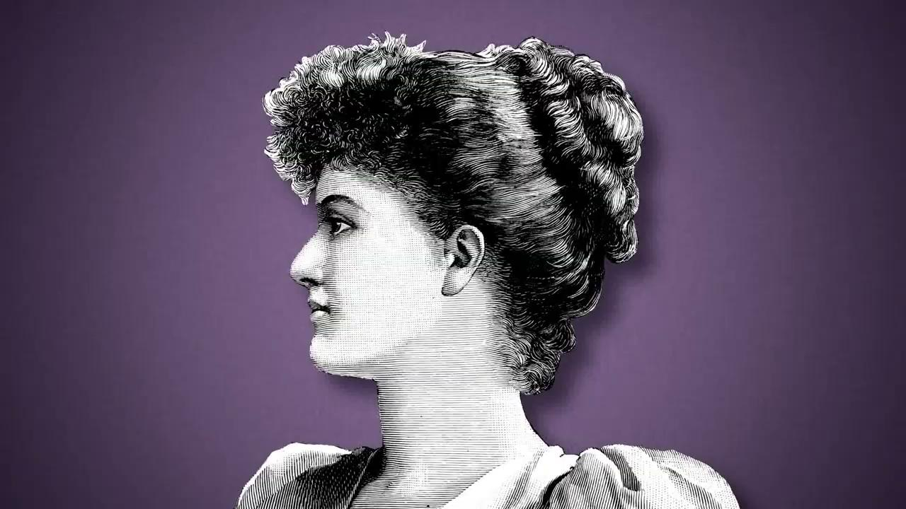
| Empathy
Video

Slide 43
| Empathy
Map
LOVE
CARING
nurturing
EMPATHY
relating
understanding
Show Merchant that we
CARE
COMMUNICATION
Make Merchant feel
Important & Welcomed

Slide 44
| Empathy
Verbiage Examples
I understand why you feel that way
I can understand how frustrating it is when…
I cannot imagine how upsetting it is to
If I were in your position, I’d feel the same way
I realize how complicated it is to
I completely understand where you’re coming from
I know how confusing it must be when…
We want to get to the bottom of this just as much as you do
This is no more acceptable to us than it is to you
If I were in your position, I would feel just as you do

Slide 45

Feature vs. Value Selling

Slide 46




| Feature vs. Value Selling
Introduction
Cloth
Unbreakable
Steel
Hot
Rain
Feature
Value
A feature describes the product attributes, aspects & capabilities, while a value describes the product’s features & benefits.
Customer wants to buy something which brings benefits.

Slide 47



| Feature vs. Value Selling
Example
What Does Value Selling Mean?
Example
Value is the perceived benefit that the merchant will get from our product.
If we believe that a feature will benefit Merchant, that does not guarantee that they will agree.
It is essential that merchant and we share the same understanding of the feature's potential benefits.
Inventory Management
Feature
Track Stock
Advantage
Value
Prevent theft thereby conserving money

Slide 48
| Feature vs. Value Selling
Features
Feature | Advantage | Benefit/Value
Beep Ordering | Waiter don’t need to spend time to take order Lowers chances of wrong order taken | Cut down on manpower and overall reduction in cost of operations Reduce in wastage, and happier customers overall
Beep Cashback / Store Credits | Lowers time taken to key in customer details Encourages customers to return more through loyalty points | Able to obtain more customer data, and allows for better marketing actions Increases the revenue generated by the business from returning customers
Auto Promotions | Employee don’t need to manually key in discounts | Employees won’t be able to give out discounts as they want Better control for multi-outlet businesses who want to limit & control their discount

Slide 49

Consultative vs. Provocative Selling

Slide 50


| Consultative vs. Provocative Selling
Consultative Selling: Introduction
Consultative selling is a sales strategy that prioritises relationships and open communication in order to identify and provide solutions for a merchant's needs
Use curiosity to deeply understand Merchant needs such as:
What do you want to achieve?
What are you currently doing?
What’s working well?
Consultative Selling
Challenges
Inbound Sales
Needs
Solution

Slide 51
| Consultative vs. Provocative Selling
Consultative Selling: Scenarios
Miss Angela, how are you currently tracking your sales
I’m currently doing it manually with pen and paper in a book
I see, do you record it yourself or does your staff do the recording for you?
My staff normally does it for me
StoreHub
Do they miss any out
Merchant
Sometimes
How often does that happen?
About 3 times a day
How does this affect your sales numbers
Every month it doesn’t tally at all.
I’m not sure if my business is making money or losing money

Slide 52
| Consultative vs. Provocative Selling
Provocative Selling: Introduction
In provocative selling, the sales person focuses on identifying opportunities or issues that the Merchant is unaware of
Use curiosity to deeply understand merchant needs such as:
What do you want to achieve?
What are you currently doing?
What’s working well?
Provocative Selling
Suggestions
Outbound Sales
Problems
Solution

Slide 53
| Consultative vs. Provocative Selling
Provocative Selling: Scenarios
Are you currently selling online?
I’m not selling online now
I see, may I know why?
I don’t think I want to go towards that direction now, maybe in the future
StoreHub
But Miss Lea, do you realise that nowadays most businesses are selling online?
Merchant
Yes I’m aware, but I don’t think it’s for me
Oh I see, but are you looking to generate more sales for your business?
Yes, I am
If you are looking to generate more sales, don’t you think a new avenue would help?
Yes, but I’m not sure if it’s worth the effort
Sure, let me show you how easy it is for you to generate more sales with online

